Slide 1
Therapists template
Click to start

Slide 2
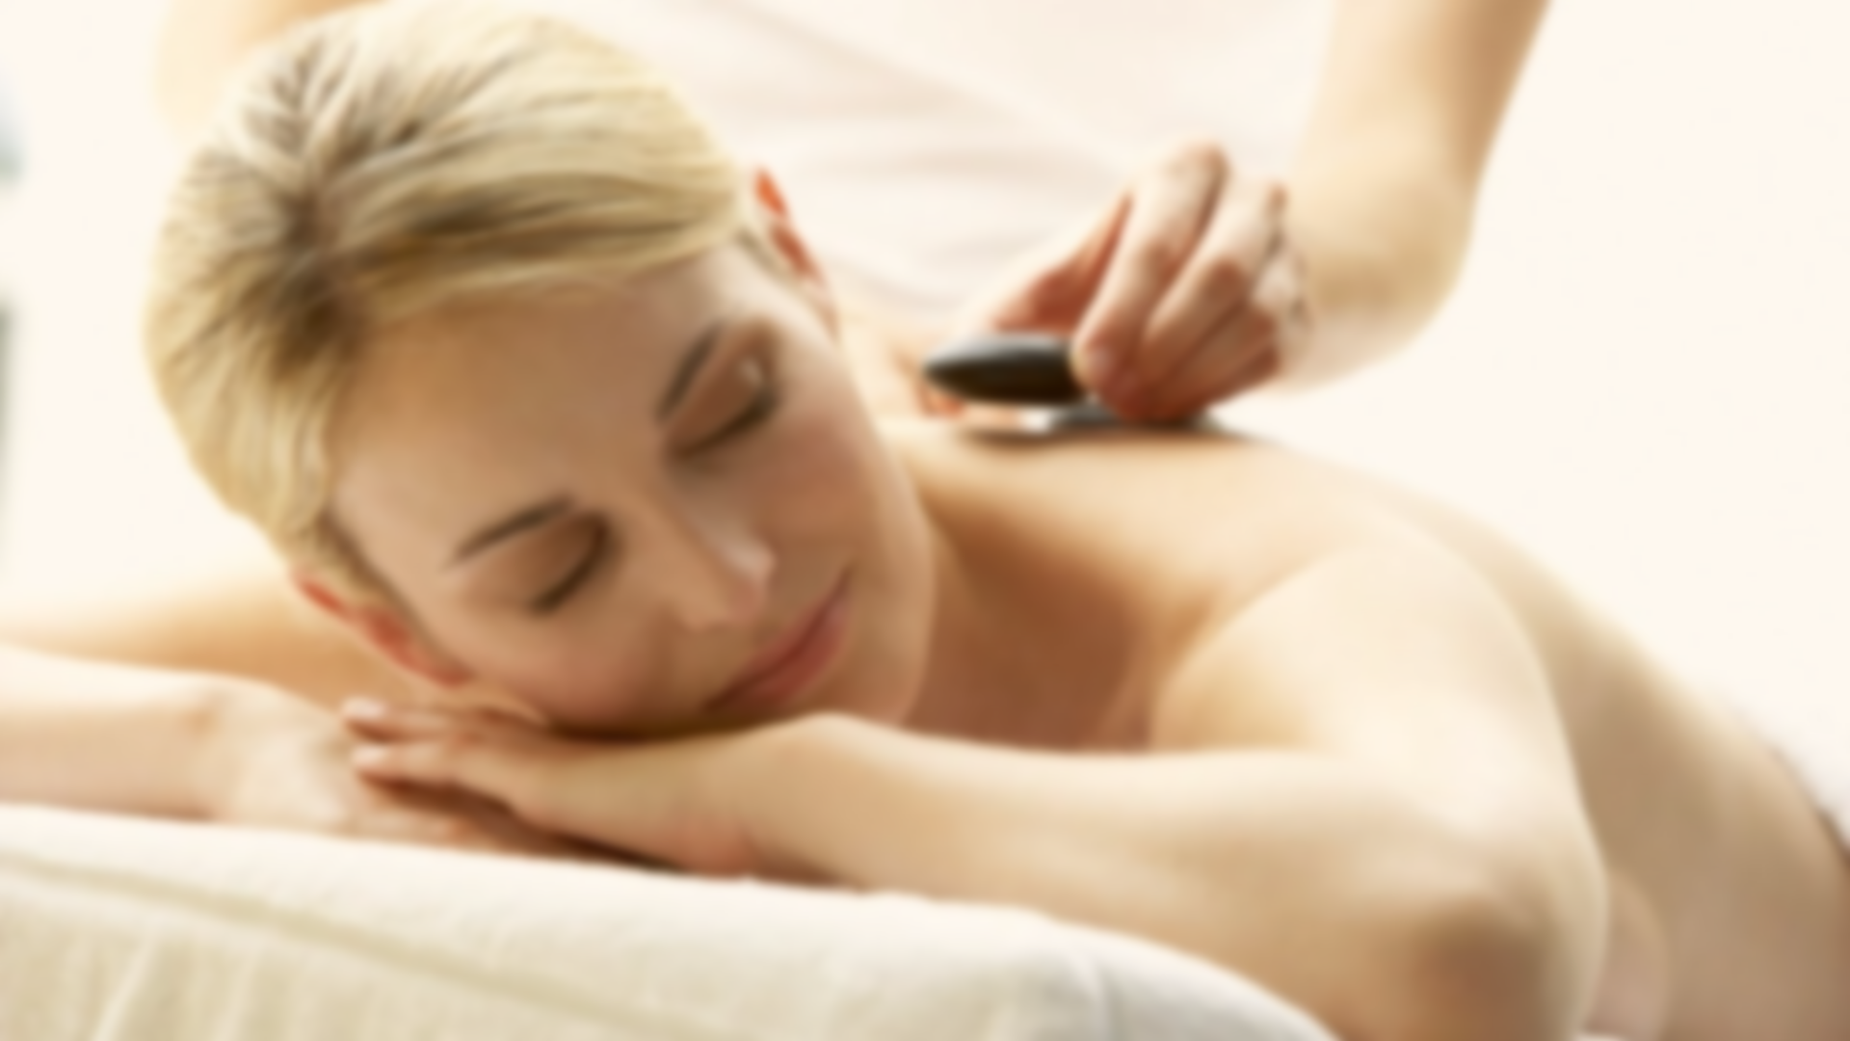


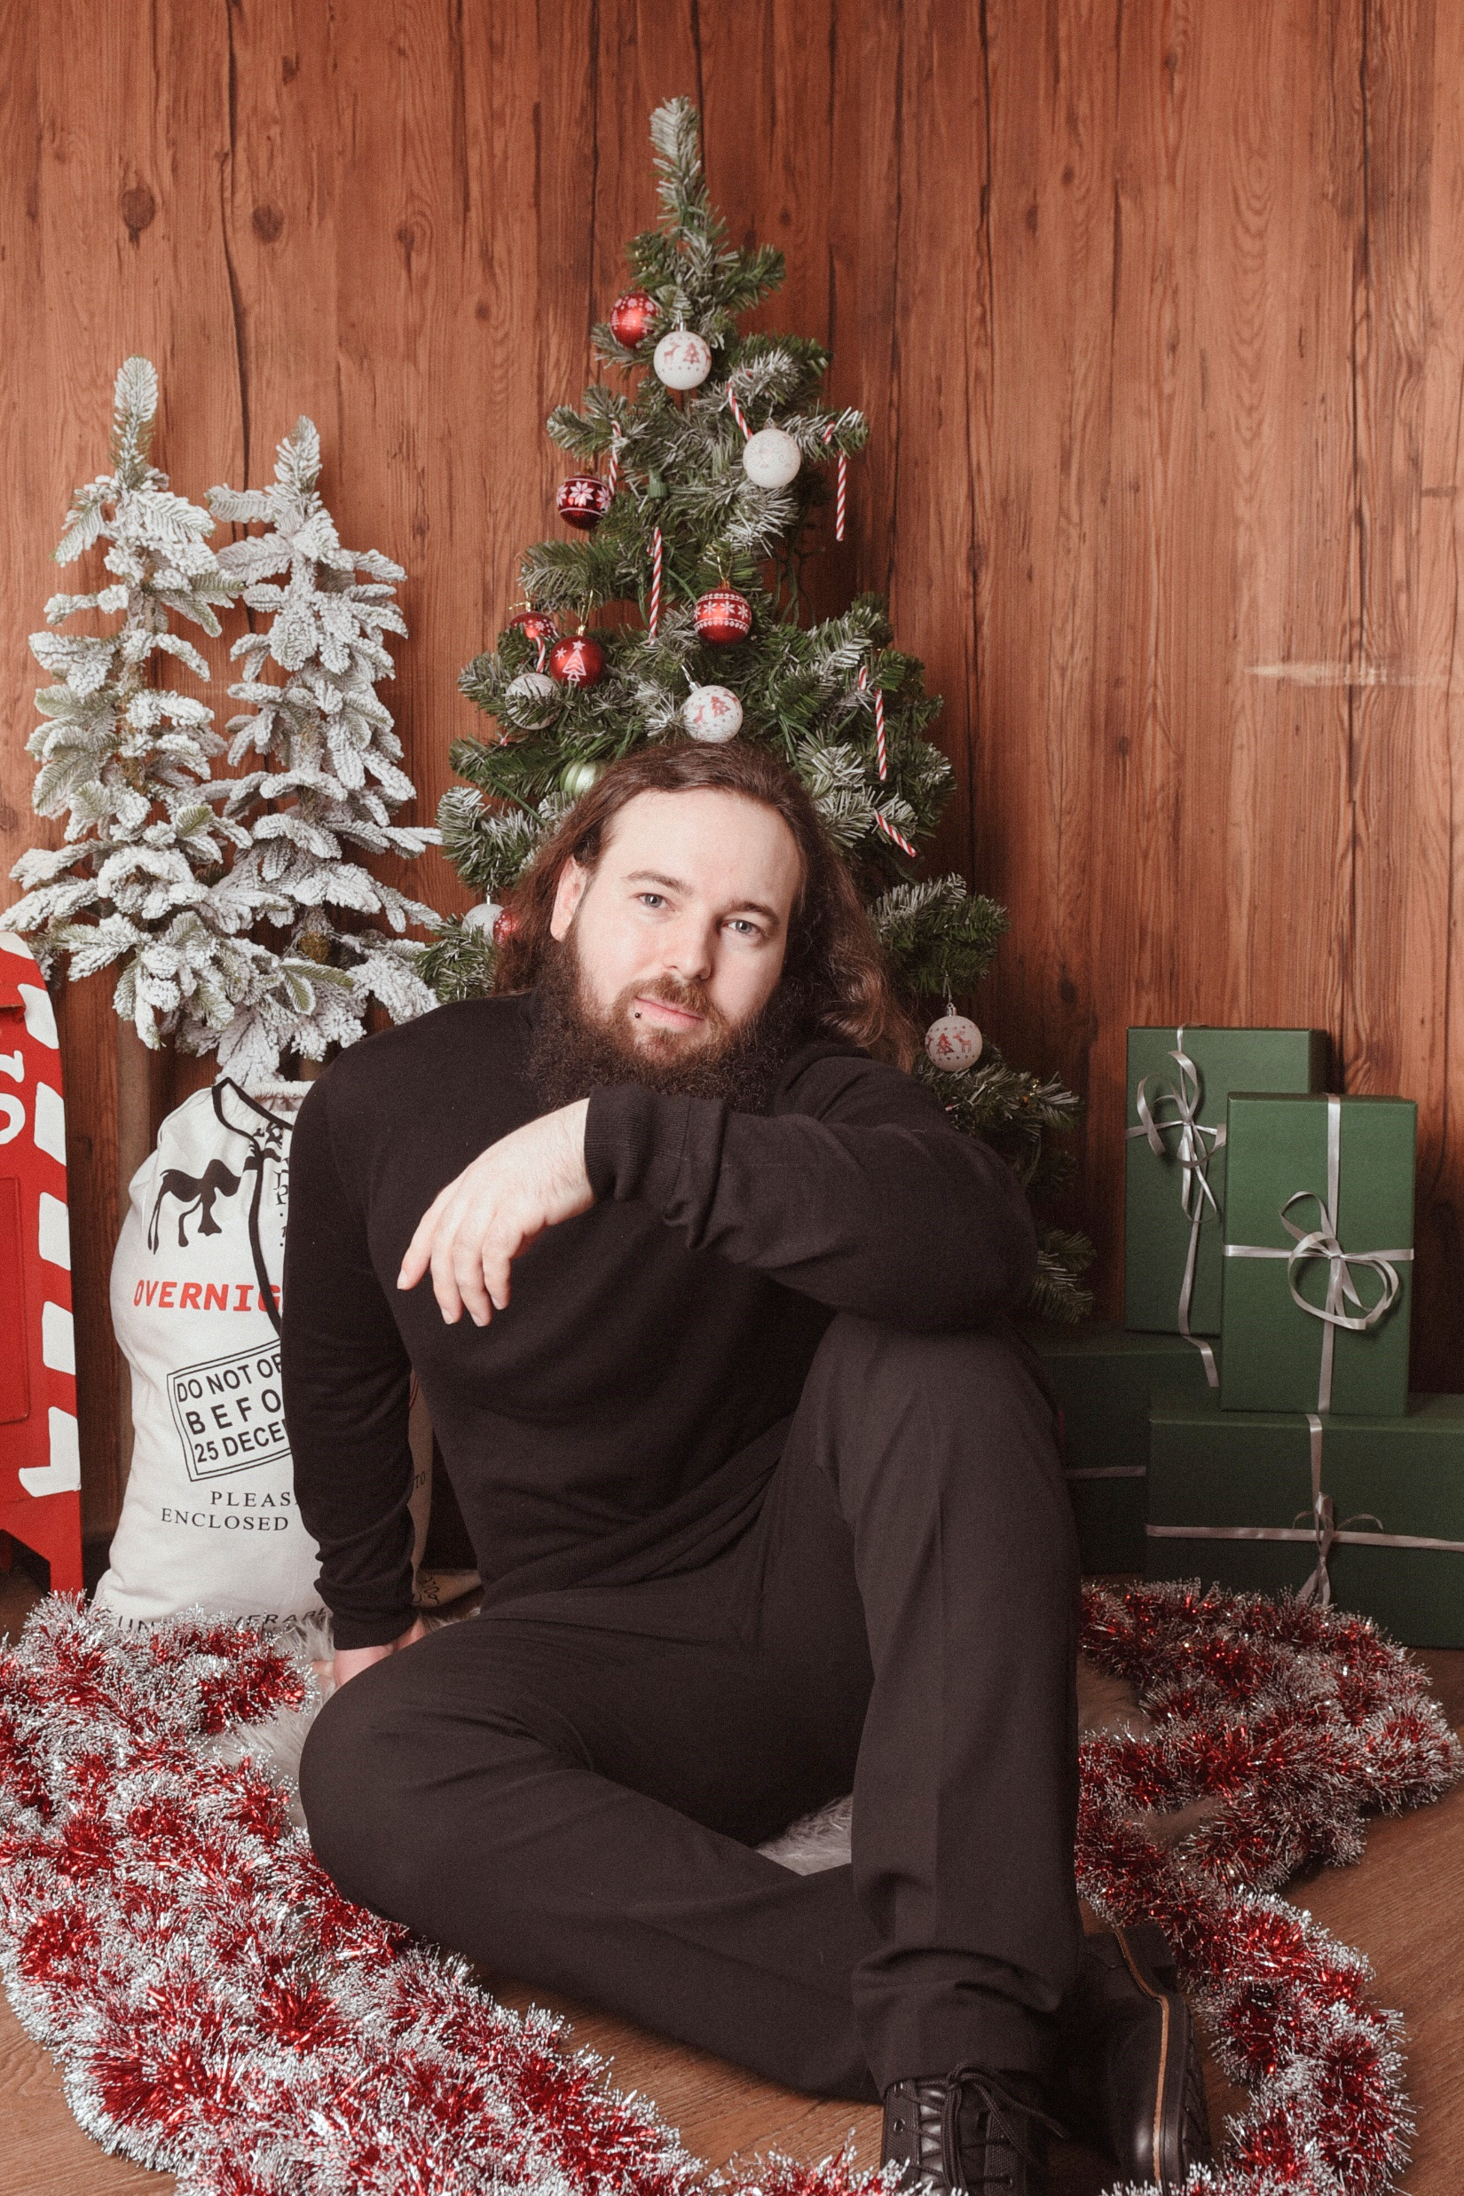

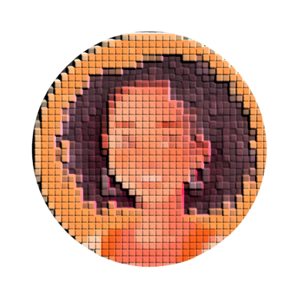

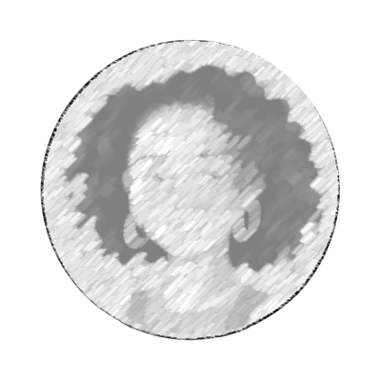





Home
Therapists
Book now
About us
Contacts
Profile
Sign out
Germany Mobile Spa
Friedrichstraße 90, 10117 Berlin
Country
Find by city
Services
Sort by city
Select gender
Roger Iskrenov Personal Yoga Trainer
Unter den Linden 12, 10117 Berlin 0.19 km away
Liam Harrison Sports Massage Therapist
Schulterblatt 36, 20357 Hamburg 257.54 km away
Sofia Bennett Deep Tissue Specialist
Schönhauser Allee 142, 10437 Berlin 3.62 km away
Jasper Malik Thai Yoga Massage Trainer
Neckarstraße 115, 70190 Stuttgart 509.21 km away
Elena Navarro Hot Stone Massage Practitioner
Karl-Marx-Straße 85, 12043 Berlin 5.12 km away
Marcus Petrov Myofascial Release Therapist
Königstraße 44, 70173 Stuttgart 511.06 km away
Maria Hopkin Thai Therapist
Kurfürstendamm 213, 10719 Berlin 5.56 km away
Amelia Chen Reflexology Expert
Calwer Straße 23, 70173 Stuttgart 511.35 km away
Maya Gupta Prenatal Massage Expert
Alsterufer 31, 20354 Hamburg 255.55 km away
Natalie Koenig Aromatherapy Massage Therapist
Reeperbahn 100, 20359 Hamburg 257.02 km away

Slide 3
Home
Therapists
Book now
About us
Contacts
Profile
Sign out
Germany Mobile Spa
Friedrichstraße 90, 10117 Berlin
Germany
Berlin
Services
Sort by city
Select gender
Berlin
Elena Navarro Hot Stone Massage Practitioner
Karl-Marx-Straße 85, 12043 Berlin 5.12 km away
Maria Hopkin Thai Therapist
Kurfürstendamm 213, 10719 Berlin 5.56 km away
Sofia Bennett Deep Tissue Specialist
Schönhauser Allee 142, 10437 Berlin 3.62 km away
Roger Iskrenov Personal Yoga Trainer
Unter den Linden 12, 10117 Berlin 0.19 km away

Slide 4
Home
Therapists
Book now
About us
Contacts
Profile
Sign out
Germany Mobile Spa
Friedrichstraße 90, 10117 Berlin
Germany
Berlin
Services
Sort by city
Select gender
Thai Massage
Berlin
Relaxing Oil Massage
Elena Navarro Hot Stone Massage Practitioner
Karl-Marx-Straße 85, 12043 Berlin 5.12 km away
Deep Tissue Massage
Slimming Massage
Jet Lag Recovery Massage
Maria Hopkin Thai Therapist
Kurfürstendamm 213, 10719 Berlin 5.56 km away
Myofascial Massage
Pregnancy Massage
Schönhauser Allee 142, 10437 Berlin 3.62 km away
Foot Massage
Sofia Bennett Deep Tissue Specialist
Foot Scrub
Body Scrub
Roger Iskrenov Personal Yoga Trainer
Unter den Linden 12, 10117 Berlin 0.19 km away
Facial Treatment
Manicure
Pedicure
Yoga Personal Training

Slide 5
Home
Therapists
Book now
About us
Contacts
Profile
Sign out
Germany Mobile Spa
Friedrichstraße 90, 10117 Berlin
Germany
Berlin
Thai Massage
Sort by city
Select gender
Berlin
Thai Massage
Elena Navarro Hot Stone Massage Practitioner
Karl-Marx-Straße 85, 12043 Berlin 5.12 km away
Roger Iskrenov Personal Yoga Trainer
Unter den Linden 12, 10117 Berlin 0.19 km away

Slide 6
Home
Therapists
Book now
About us
Contacts
Profile
Sign out
Germany Mobile Spa
Friedrichstraße 90, 10117 Berlin
Germany
Berlin
Thai Massage
Sort by city
Select gender
Berlin
Thai Massage
Elena Navarro Hot Stone Massage Practitioner
Karl-Marx-Straße 85, 12043 Berlin 5.12 km away
Roger Iskrenov Personal Yoga Trainer
Unter den Linden 12, 10117 Berlin 0.19 km away

Slide 7
Home
Therapists
Book now
About us
Contacts
Profile
Sign out
Germany Mobile Spa
Friedrichstraße 90, 10117 Berlin
Germany
Find by city
Services
Sort by city
Select gender
Berlin
Hamburg
Elena Navarro Hot Stone Massage Practitioner
Karl-Marx-Straße 85, 12043 Berlin 5.12 km away
Natalie Koenig Aromatherapy Massage Therapist
Reeperbahn 100, 20359 Hamburg 257.02 km away
Maria Hopkin Thai Therapist
Kurfürstendamm 213, 10719 Berlin 5.56 km away
Liam Harrison Sports Massage Therapist
Schulterblatt 36, 20357 Hamburg 257.54 km away
Schönhauser Allee 142, 10437 Berlin 3.62 km away
Stuttgard
Sofia Bennett Deep Tissue Specialist
Amelia Chen Reflexology Expert
Calwer Straße 23, 70173 Stuttgart 511.35 km away
Roger Iskrenov Personal Yoga Trainer
Unter den Linden 12, 10117 Berlin 0.19 km away
Marcus Petrov Myofascial Release Therapist
Königstraße 44, 70173 Stuttgart 511.06 km away
Hamburg
Maya Gupta Prenatal Massage Expert
Alsterufer 31, 20354 Hamburg 255.55 km away
Jasper Malik Thai Yoga Massage Trainer
Neckarstraße 115, 70190 Stuttgart 509.21 km away

Slide 8
Home
Therapists
Book now
About us
Contacts
Profile
Sign out
Germany Mobile Spa
Friedrichstraße 90, 10117 Berlin
Germany
Find by city
Services
Sort by city
Select gender
Male
Berlin
Hamburg
Female
Elena Navarro Hot Stone Massage Practitioner
Karl-Marx-Straße 85, 12043 Berlin 5.12 km away
Natalie Koenig Aromatherapy Massage Therapist
Reeperbahn 100, 20359 Hamburg 257.02 km away
Any
Maria Hopkin Thai Therapist
Kurfürstendamm 213, 10719 Berlin 5.56 km away
Liam Harrison Sports Massage Therapist
Schulterblatt 36, 20357 Hamburg 257.54 km away
Schönhauser Allee 142, 10437 Berlin 3.62 km away
Stuttgard
Sofia Bennett Deep Tissue Specialist
Amelia Chen Reflexology Expert
Calwer Straße 23, 70173 Stuttgart 511.35 km away
Roger Iskrenov Personal Yoga Trainer
Unter den Linden 12, 10117 Berlin 0.19 km away
Marcus Petrov Myofascial Release Therapist
Königstraße 44, 70173 Stuttgart 511.06 km away
Hamburg
Maya Gupta Prenatal Massage Expert
Alsterufer 31, 20354 Hamburg 255.55 km away
Jasper Malik Thai Yoga Massage Trainer
Neckarstraße 115, 70190 Stuttgart 509.21 km away

Slide 9
Home
Therapists
Book now
About us
Contacts
Profile
Sign out
Germany Mobile Spa
Friedrichstraße 90, 10117 Berlin
Germany
Find by city
Services
Sort by city
Male
Berlin
Roger Iskrenov Personal Yoga Trainer
Unter den Linden 12, 10117 Berlin 0.19 km away
Hamburg
Liam Harrison Sports Massage Therapist
Schulterblatt 36, 20357 Hamburg 257.54 km away
Stuttgard
Marcus Petrov Myofascial Release Therapist
Königstraße 44, 70173 Stuttgart 511.06 km away
Jasper Malik Thai Yoga Massage Trainer
Neckarstraße 115, 70190 Stuttgart 509.21 km away

Slide 10
Home
Therapists
Book now
About us
Contacts
Profile
Sign out
Germany Mobile Spa
Friedrichstraße 90, 10117 Berlin
Germany
Find by city
Services
Sort by city
Male
Berlin
Roger Iskrenov Personal Yoga Trainer
Unter den Linden 12, 10117 Berlin 0.19 km away
Hamburg
Liam Harrison Sports Massage Therapist
Schulterblatt 36, 20357 Hamburg 257.54 km away
Stuttgard
Marcus Petrov Myofascial Release Therapist
Königstraße 44, 70173 Stuttgart 511.06 km away
Jasper Malik Thai Yoga Massage Trainer
Neckarstraße 115, 70190 Stuttgart 509.21 km away

Slide 11



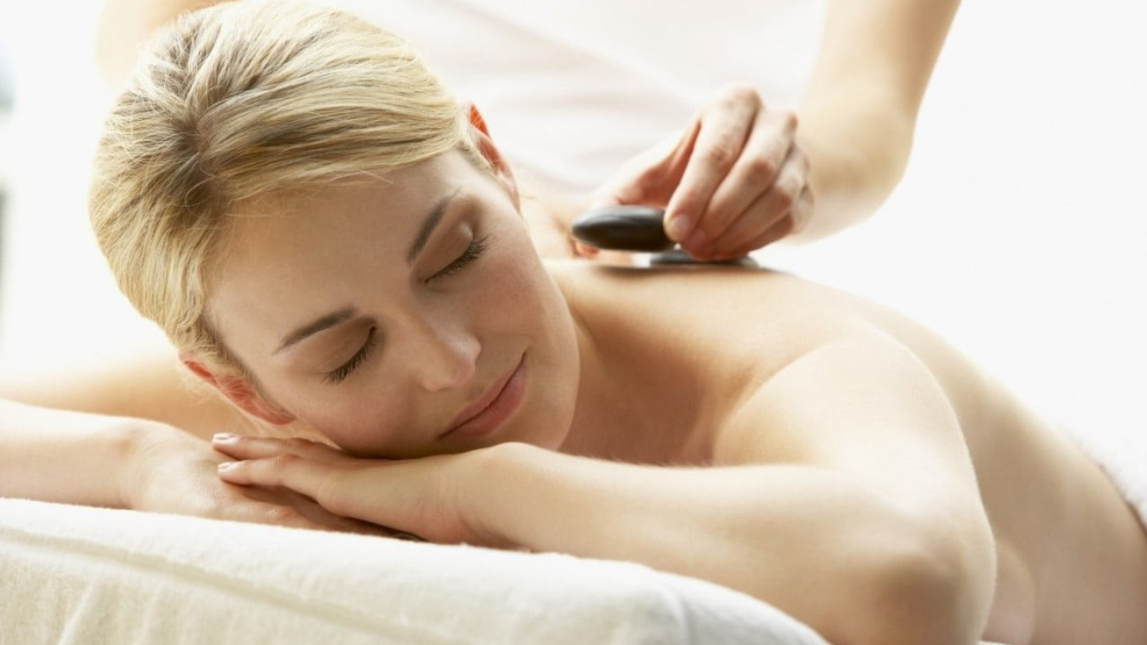
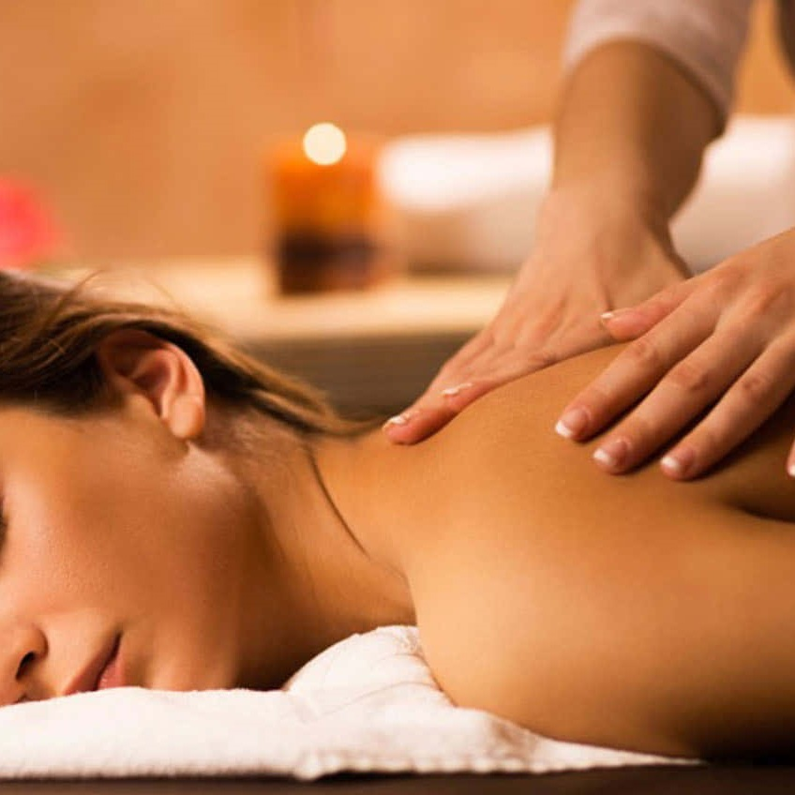
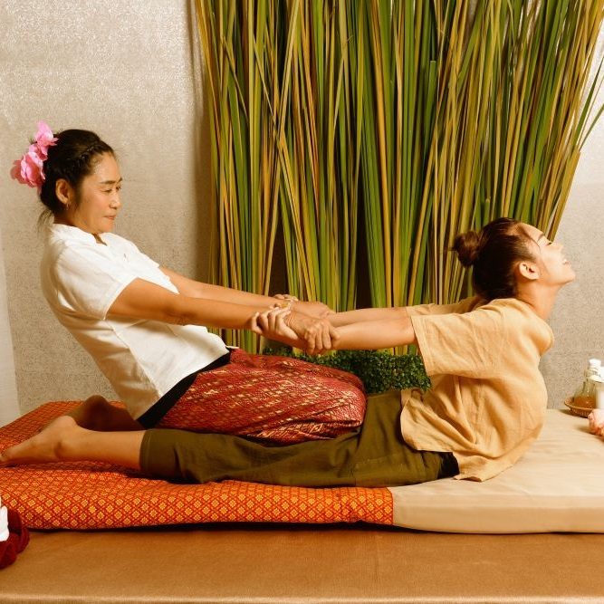
Home
Therapists
Book now
About us
Contacts
Profile
Sign out
Germany Mobile Spa
Roger Iskrenov
Certifications & Training:
Provided equipment: 5 Towels, 2 Chairs
Required equipment: 1 Table, 1 Bed
Specializations: Deep Tissue Massage, Thai Massage
Verified practitioner pronouns: He/Him
"Hi, I’m a certified massage therapist and personal yoga trainer with over 10 years of experience helping clients achieve balance, relaxation, and well-being. My holistic approach combines therapeutic massage techniques with personalized yoga sessions to bring harmony to body and mind."
Add to favorites
Request
Gallery
Services

Slide 12
Home
Therapists
Book now
About us
Contacts
Profile
Sign out
Germany Mobile Spa
Services
Our practitioners are available daily from 8.00am until 7.00pm. If requiring services after 7.00pm additional 200 Baht/hour will be added to each service.
Thai Massage
Experience the ancient art of Thai massage. A therapeutic practice that combines gentle stretching, acupressure, and rhythmic movements. This full-body treatment promotes flexibility, relieves tension, and restores balance, leaving you refreshed and rejuvenated.
60 minutes: 25.00 € 90 minutes: 35.00 € 120 minutes: 45.00 €
Relaxing Oil Massage
Deep Tissue Massage
Slimming Massage
Jet Lag Massage
Myofascial Massage
Pregnancy Massage
Foot Massage
Foot Scrub
Body Scrub
Facial Treatment
Yoga Personal Trainer
Manicure
Pedicure

Slide 13
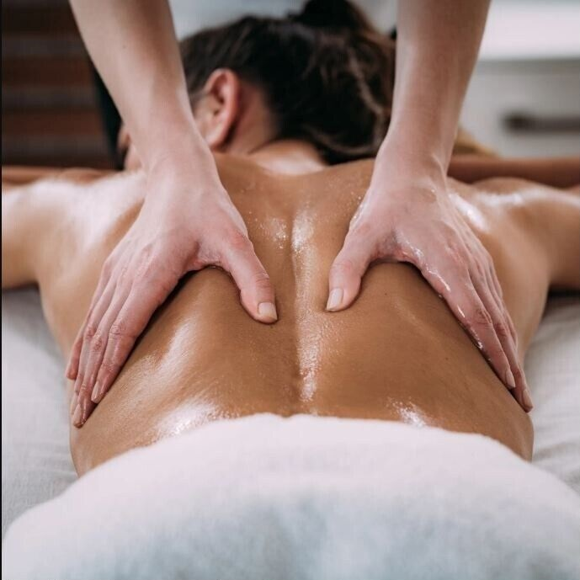
Home
Therapists
Book now
About us
Contacts
Profile
Sign out
Germany Mobile Spa
Services
Our practitioners are available daily from 8.00am until 7.00pm. If requiring services after 7.00pm additional 200 Baht/hour will be added to each service.
Thai Massage
Indulge in a Relaxing Oil Massage, designed to melt away stress and soothe your senses. Smooth, flowing strokes with aromatic oils ease muscle tension, enhance circulation, and promote deep relaxation, leaving you feeling calm, refreshed, and rejuvenated.
60 minutes: 25.00 € 90 minutes: 35.00 € 120 minutes: 45.00 €
Relaxing Oil Massage
Deep Tissue Massage
Slimming Massage
Jet Lag Massage
Myofascial Massage
Pregnancy Massage
Foot Massage
Foot Scrub
Body Scrub
Facial Treatment
Yoga Personal Trainer
Manicure
Pedicure

Slide 14
Home
Therapists
Book now
About us
Contacts
Profile
Sign out
Germany Mobile Spa
Discover the Benefits of Massage Therapy:
Relieves stress and anxiety
Eases muscle tension and pain
Improves circulation and flexibility
Boosts immune function and mental clarity
Why Choose Us? At [Your Business Name], we combine skill, care, and a serene environment to provide you with the ultimate relaxation experience. Our certified therapists customize each session to your needs, helping you unwind, rejuvenate, and restore balance.
Rechtliches
Impressum Datenschutzerklärung Einwilligungen widerrufen Historie der Privatsphäre-Einstellungen Privatsphäre-Einstellungen ändern
float HafenCity
Am Kaiserkai 42 20457 Hamburg Tel: 040 / 70 38 37 30 hafencity@float-hamburg.com
tägl. 10:00 – 22:00 Uhr
float Neustadt
Alter Steinweg 1 20459 Hamburg Tel: 040 / 36 93 54 64 neustadt@float-hamburg.com
tägl. 10:00 – 22:00 Uhr
float Rotherbaum
Mittelweg 160 20148 Hamburg Tel: 040 / 21 00 69 89 rotherbaum@float-hamburg.com
tägl. 10:00 – 22:00 Uhr
© 2024 [Your Business Name]. All rights reserved.
Follow us: [Social Media Icons]

